Slide 1
OpenDSS Agent for RIAPS
Institute for Software Integrated Systems
Vanderbilt University
Created by: Purboday Ghosh

Slide 2
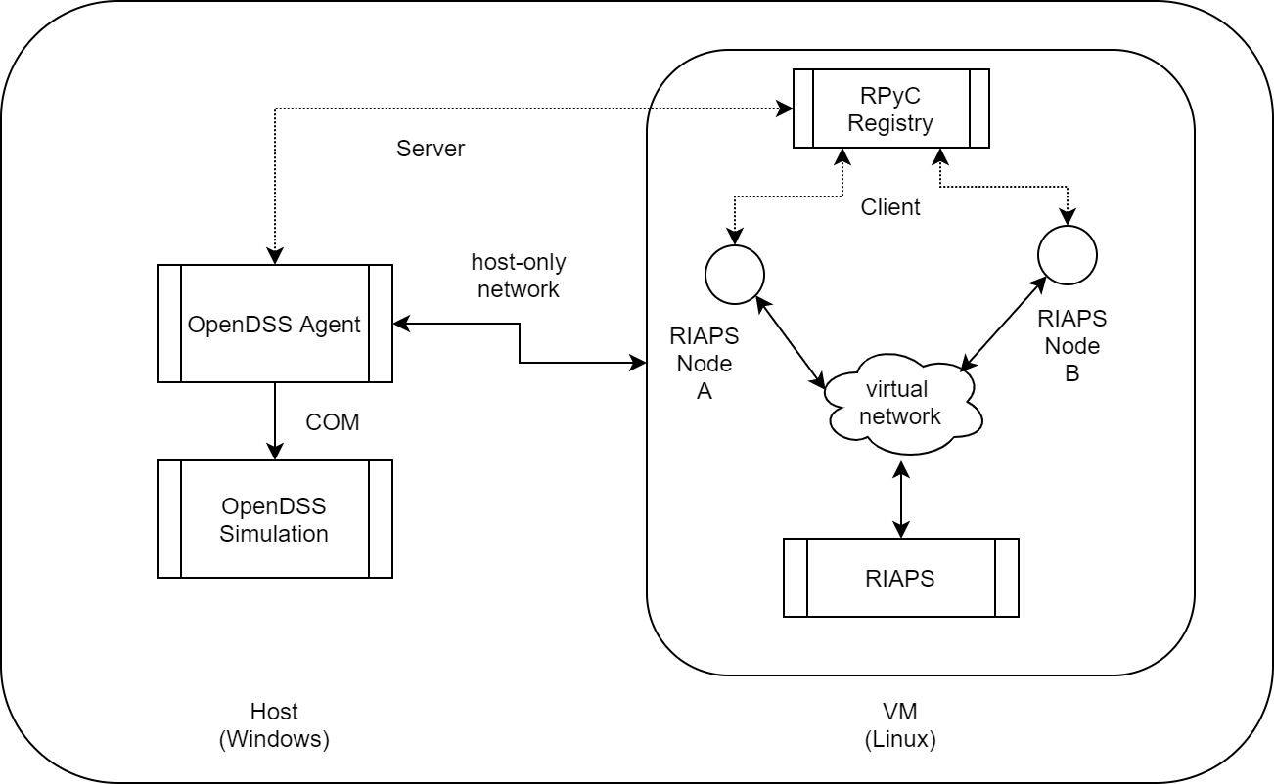
Architecture

Slide 3
Part I: The Agent
Needs to be run on Windows.
Installation:
Install dependencies (see requirements.txt)
Clone the repository (https://github.com/RIAPS/interface.OpenDSS)
Network set up:
Set up a Host-only Adapter in VirtualBox.
Add routing rules for working with mininet “route add 192.168.57.0/24 <vm host only interface ip address> metric 1”

Slide 4
Part II: RIAPS App
Needs to be run from the VM.
An instance of the rpyc registry server needs to be running.
Any RIAPS app designed must use the OpenDSS.py device component to communicate with the agent (provided in both the interface and example repositories).
If using mininet, then it needs to be installed.
The default services “riaps-rpyc-registry.service” and “riaps-deplo.service” needs to be disabled.
Use the setup and deployment scripts provided in the example repository as guidelines (see detailed instructions in the readme) (https://github.com/RIAPS/example.varcontrol).

Slide 5
Publish-Subscribe-Query Interfaces
Need to send appropriate messages in the proper format to the command port of the device component to set up the interfaces.
Subscribe –
sets up the receipt of a subscription message on each cycle of the simulation.
Message format: ['sub’, (object,name,attribute)]
Receive format: (object,name,attribute,value,simulation_time)
Publish –
Send commands to modify or set some parameters of the simulation.
Message format: ['pub’, (object,name,atrribute,new_value)]
Query –
One time request for a parameter value. Returns with an answer.
Message format: ['qry', (object,name,attribute)]
Return format: (object,name,attribute,value,simulation_time)

Slide 6
Agent Configuration
Configure parameters for the agent and the simulation in a “dssa.yaml” file.
Needs to be in the same path as the model.
Parameters that can be customized:
Simulation Stepsize
Total number of simulation steps
Solution Mode
Physical time interval between each simulation iteration
Time window to wait for receiving control commands etc.
Example file provided in the sample directory of the interface repository.

Slide 7
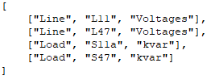
Logging
All subscribed and published quantities can be logged using InfluxDB database.
Install InfluxDB (in windows or VM).
Run the InfluxDB server.
If running on the VM specify dbhost, dbport fields in the dssa.yaml file (sample provided with the agent).
It can be connected to Grafana to create charts and graphs.
Logging is controlled using “modelname.dsl” file.
Add entries that need to be logged as: [[Object, Name, Attribute],…]
It needs to be in the same directory as the model.

Slide 8
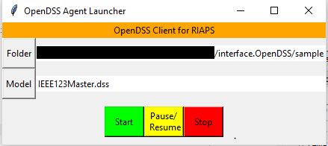
Running the simulation
Make sure a registry service is running on the VM.
Run “dssa_gui.py” to launch the gui.
Select the model folder.
Select the model file.
Click on Start.
The simulation can also be paused, stopped by clicking the corresponding buttons.
On the VM, select and launch the app model and deployment files on RIAPS.
If Grafana is set up: open the url (default port 3000) to look at the results.

Slide 9
Thank You

